Slide 1
Global crude market overview
Vyacheslav Mischenko – Argus Media SVP – Russia & FSU
8 November 2016, ESCP London

Slide 2
Preliminaries
Copyright notice
Copyright © 2016 Argus Media Limited (“Argus”). All rights reserved. All intellectual property rights in this presentation and the information herein are the exclusive property of Argus and and/or its licensors and may only be used under licence from Argus. Without limiting the foregoing, by reading this presentation you agree that you will not copy or reproduce any part of its contents (including, but not limited to, single prices or any other individual items of data) in any form or for any purpose whatsoever without the prior written consent of Argus.
Disclaimer
All data and other information presented (the “Data”) are provided on an “as is” basis. Argus makes no warranties, express or implied, as to the accuracy, adequacy, timeliness, or completeness of the Data or fitness for any particular purpose. Argus shall not be liable for any loss or damage arising from any party’s reliance on the Data and disclaims any and all liability related to or arising out of use of the Data to the full extent permissible by law.

Slide 3
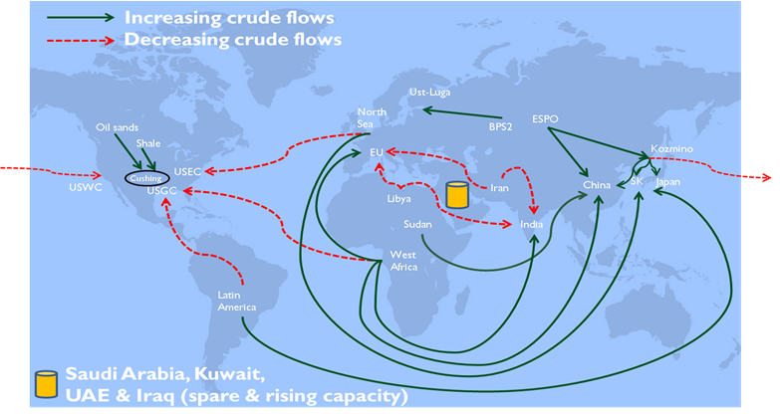
2016 - seismic changes in world oil trade
Lifting of US export ban
Removal of Iran nuclear sanctions
Opec raises prospect of output cuts
Oil stocks at record highs
Second year of declining upstream investment

Slide 4
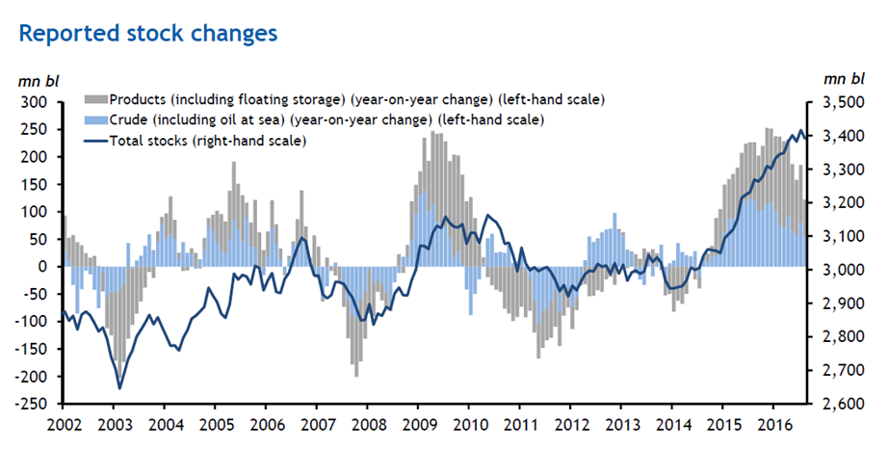
The scale of the overhang
Argus Fundamentals

Slide 5
US exports flow
Source: EIA

Slide 6
A responsive market
Source: EIA, Argus Crude

Slide 7
Reconnecting to the world
The lifting of the US export ban has not opened the floodgates.
It has simply helped US markets to respond to those elsewhere and establish the arbitrage more clearly.
This helps US refiners to know whether to buy domestically or to import.
2016 has seen increasing net imports, despite the lifting of the export ban.
Sources: EIA, Argus Crude

Slide 8

Futures volumes go west
The US Gulf coast is emerging as the pricing point for the global marginal supply barrel (US tight oil)
Most crude is still priced against Brent or Dubai, but those benchmarks face challenges of liquidity and confidence.
This has boosted trade in WTI futures and physical crude benchmarks linked to their settlement price.
Sources: EIA, CME, ICE

Slide 9
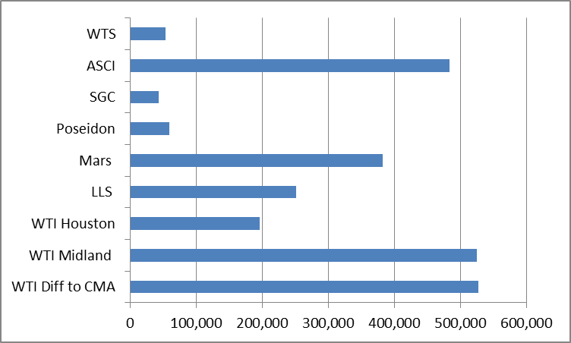
US Gulf coast could become world’s price discovery hub
US Gulf Sept 2016 spot trade volumes (b/d)
Average Physical Volume | Avg trade month vol Jun-Aug 2016 (b/d)
Argus Sour Crude Index (ASCI) | 420,269
Argus WTI Midland | 501,334
Argus Mars | 321,454
North Sea Forwards | 436,923
BFOE Physical Cargoes | 286,154
Argus LLS | 298,692
Argus WTI Houston | 131,298
US Gulf could become leading price discovery area; eclipsing North Sea
Unlikely to be a transparent FOB USGC cargo market.
US and Canadian exports will be priced versus alternative domestic market.
Financial products established indexed to Argus VWAs.
Argus index methodology already well established.
Argus has launched delivered prices for US crude in China.
Notes:
Leads us to talk of exports

Slide 10
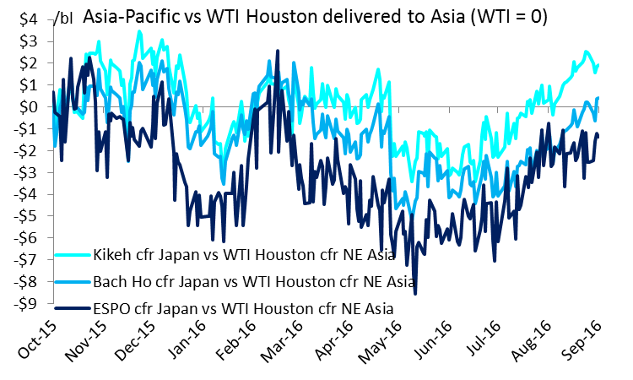
US is now competitive against local grades in Asia

Slide 11
Freight rates favour the long haul
Cost of transportation likely to stay low.
24 new VLCCs delivered in first half of 2016, up to 40 more scheduled by year end.
Reduced demand for all tankers partly due to curbed loadings from Nigeria, though this is changing as production resumes.
Build up of tankers in Mideast Gulf.
Source: Argus Freight

Slide 12
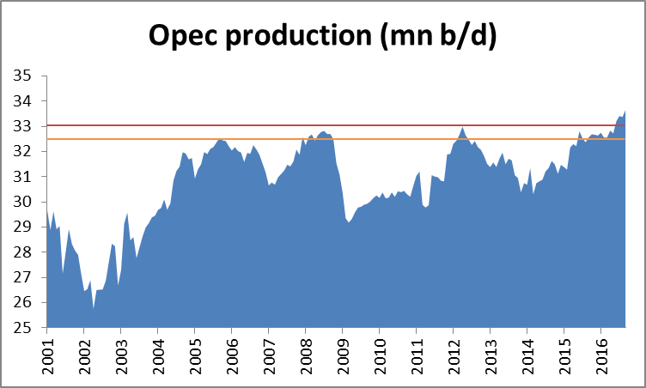
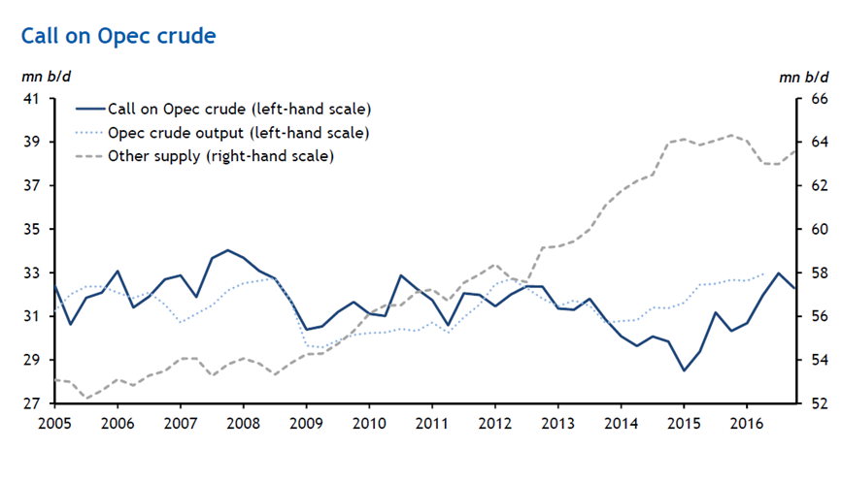
Opec decision – key considerations
Recent meetings in September-October led to an agreement to limit production to 32.5-33mn b/d.
This is 670,000-1.17mn b/d below Argus estimate of October Opec production levels of 33.67mn b/d.
Less than one month to hammer out the details and try to get Russia on board.
Saudi Arabia is already cutting production due to seasonal factors.
Argus Fundamentals

Slide 13
Will it be enough?
Libya and Nigeria will be exempt as they recover from disruptions to production.
Iran wants to hit 4mmn b/d before taking part in a freeze.
Russia hits new post-Soviet high above 11mn b/d – may freeze but not willing to cut.
Prices have climbed but the detail of the deal will not be known until the November Opec meeting.
Sources: Russian Energy Ministry
Argus FSU Energy, Argus Fundamentals

Slide 14
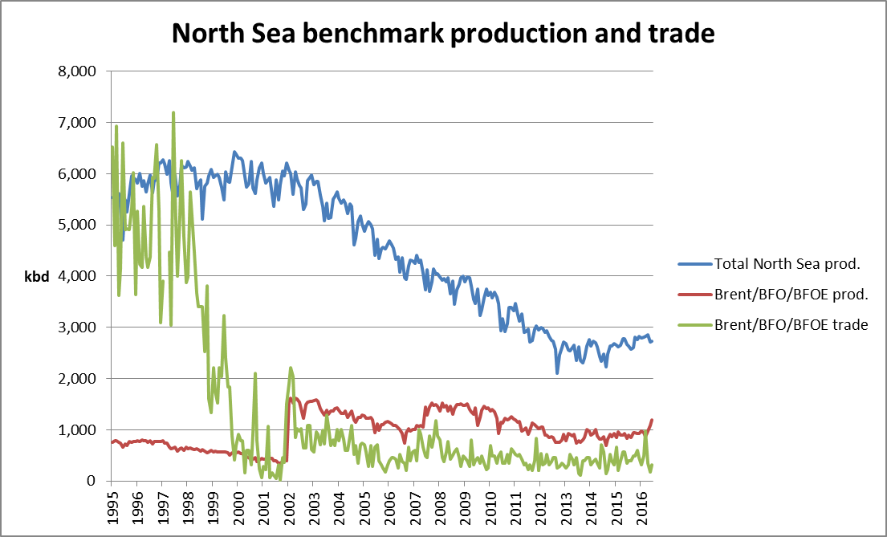
North Sea production and trade steady for now
Argus Crude

Slide 15
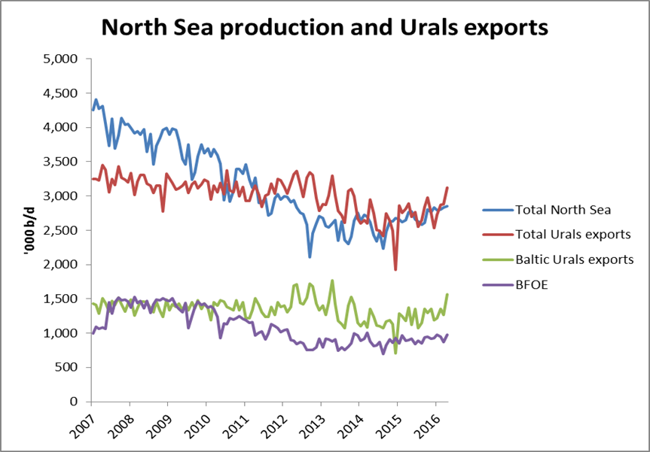
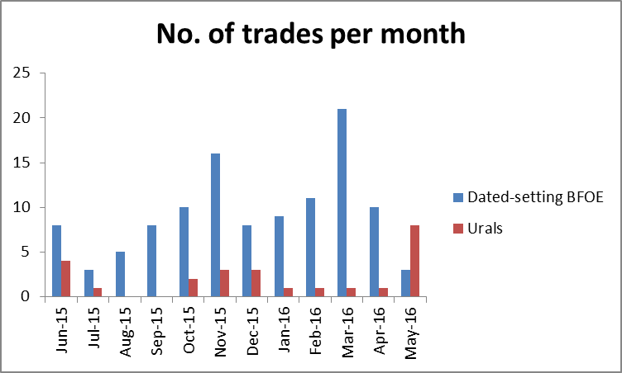
Russia has the volume
The obvious long term solution to bolster the Brent benchmark is to incorporate Russian Urals.
It is plentiful, stable, and close to the European market.
Spot market liquidity needs to improve.
Urals futures and other derivatives are developing.
Source: Argus Crude

Slide 16
Russia is looking for new export opportunities
Production of crude oil in Russia and export figures hit record high
Higher export duty for fuel oil causes less demand in the Russian domestic market and, as a result, decline of refinery throughputs and an increase in crude oil exports
Nonetheless brownfield output is down 10—15pc per year and drilling rates are down by 18pc in 2015 as companies cut operating costs. Consequently long-term forecasts are too untimely
Russian Urals remains the key spot traded flow of crude into Europe although Iranian and Iraq grades affect Urals price. It stays an informal benchmark in Mediterranean region
Meanwhile export to the East increased by 4,6% since January, and by 12,5% in 2015
Chinese companies are the number one buyers of Russian crude among Asian companies. However, sourcing Chinese alternatives will take time. Moreover, China revises downwards its demand in the northern provinces

Slide 17
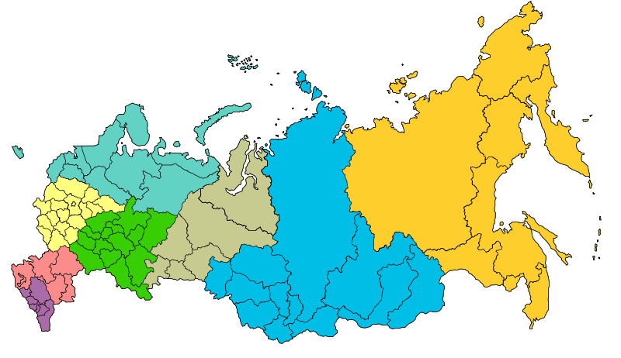
Russia is a flexible exporter with multiple outlets
Yamal
Timan-Pechora
Arctic offshore
Northwest
5%
Far East
6%
West
Siberia
56%
East
Siberia
9%
Volga-
Urals
22%
South,
Caucasus
2%
East Siberia

Slide 18
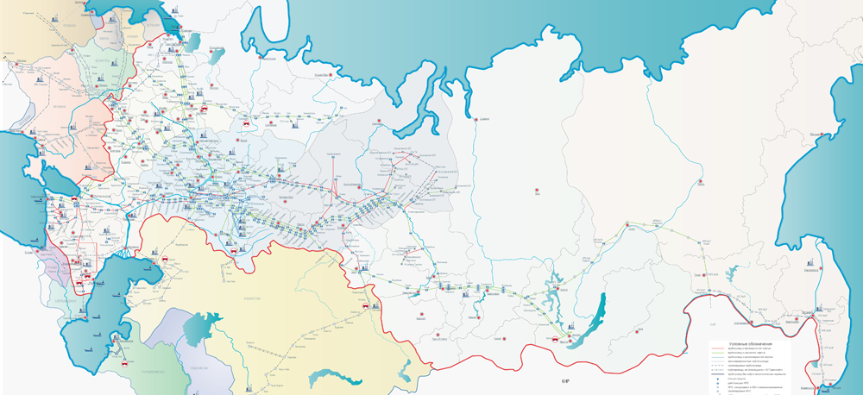
Argus-linked ESPO exports are on the rise
ESPO/Dubai
Baltic ports – 71.8 mn t
Druzhba pipeline – 53.9 mn t
Black Sea – 34.1 mn t
Sakhalin projects– 15.4 mn t
Kozmino – 30.4 mn t
FSU – 23 mn t
China – 23 mn t
Urals/Dated

Slide 19
Crude exports rising dramatically in 2015-2016
Crude exports from Russia rose by 8pc in 2015 and are expected to grow further in 2016. May exports were the highest since 1991.
Export supplies increased along all routes except via the Black Sea
Production growth in 2015 was the highest since 1991
Russia is planning to send 1/3 of its exports to the east
By 2016 ESPO supplies should reach 0.965 mn b/d from 0.945 mn b/d in 2015. By 2018 — 1.05 mn b/d
Exports bypassing Transneft system are increasing with new fields using alternative transportation routes (Trebs/Titov, Prirazlomnoye, Novy Port, Sakhalin fields etc.)
Russian Pipeline Crude Exports, mn b/d

Slide 20
Exports to the East are growing fastest
ESPO supplies (Kozmino and China), ‘000 bl/d
Russian Pipeline Crude Export, mn b/d

Slide 21
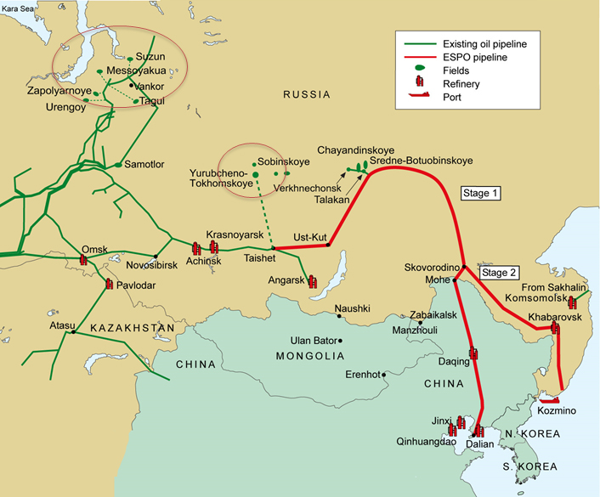
ESPO becoming a reference crude for Asia
Russian eastbound crude exports in east direction increased by 12.5pc to 1.07 mn b/d in 2015 but growth rates have slowed
In 2014 Rosneft started to deliver 140,000 b/d into China through Kazakhstan on term contract. In 2015 the company loaded around 3.1 mn t crude to CNPC in Kozmino.
In 2016 Rosneft will supply 16 mn to CNPC through pipeline Skovorodino-Daqing and around 4 mn t to Kozmino
Russian companies would like to export around 40 mn t through Kozmino in 2017. However its current capacity is 31 mn t.

Slide 22
Emerging market demand growth blunted
Demand growth is slowing in several emerging markets and steady or even declining in mature markets.
Transition to service and consumer economy in China. India remains strong.
Africa continues to grow most quickly but from lowest base.
Argus Fundamentals

Slide 23
Independent refiners: 100pc of China’s import growth
Liberalisation has driven a surge in Chinese net crude imports.
Over 30pc of crude imports entered China via Shandong this year (+950kbd YoY)
  Shandong Jan-Jul 2016 = 2.4mn b/d
  Shandong Jan-Jul 2015 = 1.5mn b/d
Excluding Shandong, Chinese imports were -1pc YoY in January-July
Strong correlation between independent output and Chinese exports of gasoline/diesel/jet
Sources: China Customs, Argus China Petroleum
Notes:
Data source: China Customs/Argus
Argus has revised up its forecast of Chinese apparent oil demand by 400,000 b/d to 11.7mn b/d compared with a year earlier. This follows a surge in crude imports that partly offsets declining domestic crude production but chiefly reflects an increase in imports of crude by so-called teakettle refiners
Oil product net imports are shrinking as Chinese exports of transport fuels grow
Domestic, high-cost crude production from the ageing Daqing and Shengli fields is shrinking
The growth in oil demand has come squarely from imports

Slide 24
Will crude become a cyclical market?
Assuming:
  Demand growth of 1.1 mn b/d per year
  Non-Opec production consistently below 2015 level until 2023
  Opec production restraint until 2021/22
  Brent at $50-60/bbl
Opec’s dilemma will not go away

Slide 25

Vyacheslav Mischenko
SVP – Russian & FSU
Email:
Phone:
Office:
Web:
Blog:
Vyacheslav.mischenko@argusmedia.com
+79337571
Moscow
www.argusmedia.com
http://blog.argusmedia.com
Stay Connected
@ArgusMedia Argus-media
+Argusmediaplus argusmediavideo
Copyright notice
Copyright © 2016 Argus Media group. All rights reserved. All intellectual property rights in this presentation and the information herein are the exclusive property of Argus and and/or its licensors and may only be used under licence from Argus. Without limiting the foregoing, by reading this presentation you agree that you will not copy or reproduce any part of its contents (including, but not limited to, single prices or any other individual items of data) in any form or for any purpose whatsoever without the prior written consent of Argus.
Trademark notice
ARGUS, the ARGUS logo, ARGUS MEDIA, ARGUS DIRECT, ARGUS OPEN MARKETS, AOM, FMB, DEWITT, JIM JORDAN & ASSOCIATES, JJ&A, FUNDALYTICS,
METAL-PAGES, METALPRICES.COM, Argus publication titles and Argus index names are trademarks of Argus Media Ltd.
Disclaimer
All data and other information presented (the “Data”) are provided on an “as is” basis. Argus makes no warranties, express or implied, as to the accuracy, adequacy, timeliness, or completeness of the Data or fitness for any particular purpose. Argus shall not be liable for any loss or damage arising from any party’s reliance on the Data and disclaims any and all liability related to or arising out of use of the Data to the full extent permissible by law.

